Slide 1
A570: Project 2
Brooke Kimsey-Miller

Slide 2
Acknowledgements
Enrico, Brandon, Greg, Ethan

Slide 3
Motivation
How does a halo affect disk formation?
Can we form a bar?

Slide 4
GitHub
Gadget2
Easiest Form of Version Control
Do at BEGINNING of Project!!
Allows easy commit change comments
Easy to upload SMALL files
Can do from terminal or GUI
Easier to recognize errors
Easy to Use
Once you know what you’re doing
Lots of parameters to pick from
Different forms of input/output
Easy to play around with

Slide 5
Four Models
2 Homogeneous Models
N_halo = 3N_disk = 30N_bulge (9000,3000,300)
From BT2008 Fig 2.3 Page 113
V = 1,1,1; 0.1, 0.1, 0.1
N_halo = N_disk = 10 N_bulge (6000,6000,600)
V = 10⁻³, 10⁻³, 10⁻³; 10⁻⁵, 10⁻⁵, 10⁻⁵
2 ‘Hernquist’ Models
N_halo = 3N_disk = 30N_bulge (18000,6000,600)
Derived Disk
Approximated Disk
3 types of plots, all have gifs

Slide 6
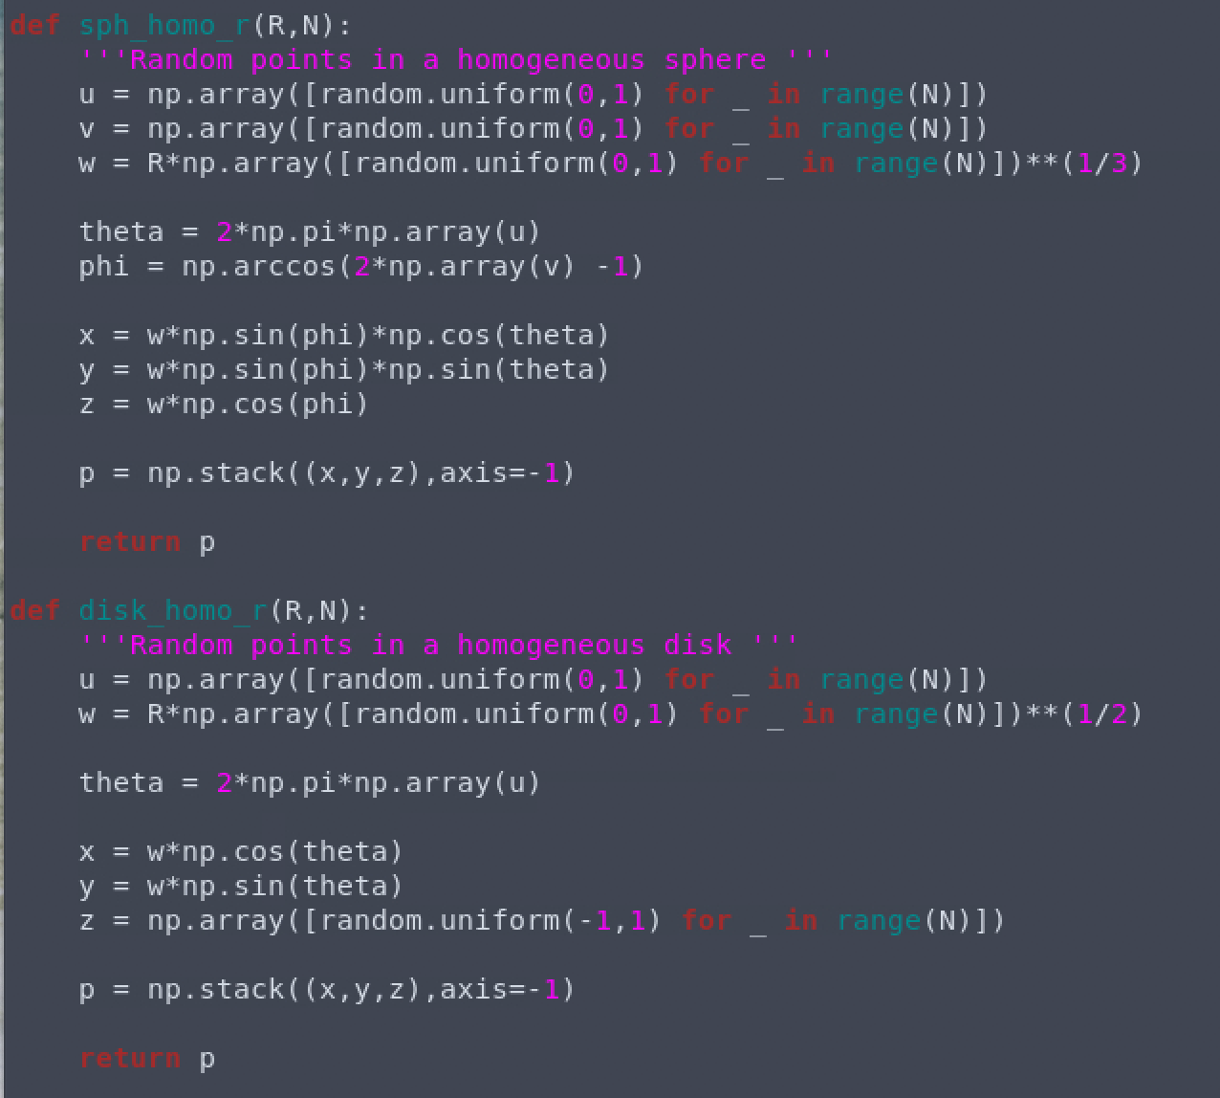
Homogeneous Models

Slide 7
Homogeneous I
Gif v1
Halo+disk+bulge & halo+disk
Disk+bulge & Isolated disk
Gif v2
Halo + disk + bulge & isolated disk
Gif v3
Halo + disk + bulge & isolated disk

Slide 8
Homogeneous II
Gif v1
Halo+disk+bulge & isolated disk
Gif v2
Halo + disk + bulge & isolated disk
Gif v3
Halo + disk + bulge & isolated disk

Slide 9
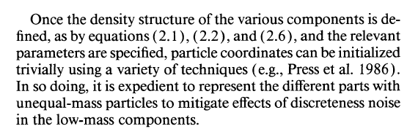
Hernquist Derivations

Slide 10
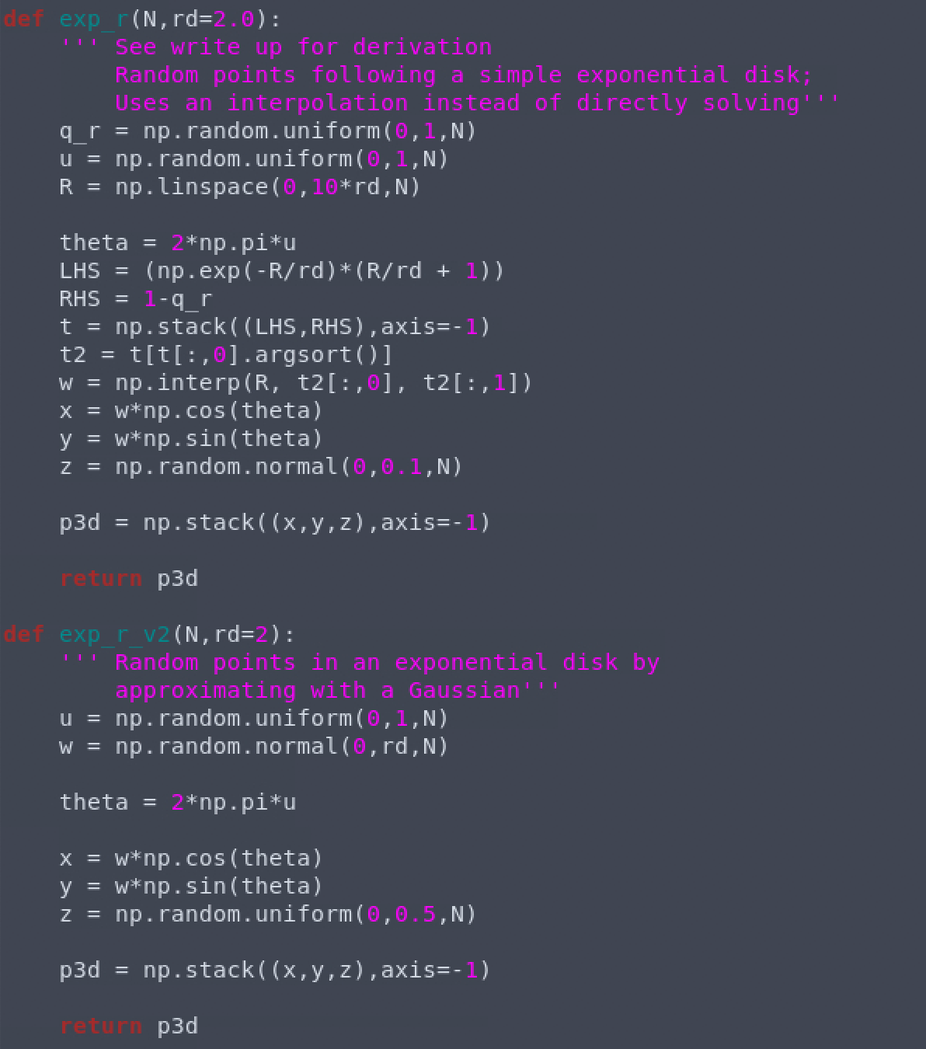

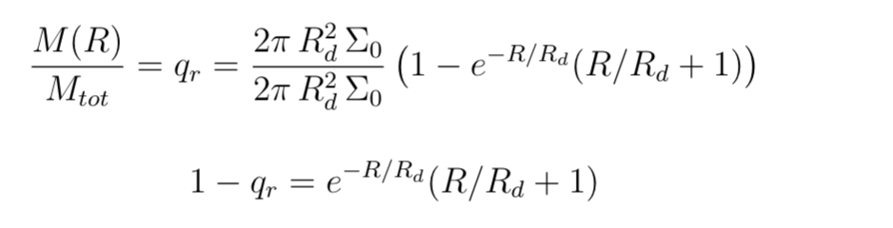
Used Derivation: Disk
Notes:
Actual density profile: I did solve M(R), wasn’t sure how to solve for R & z; i used standard exponential and added in z
np.random.uniform() versus random.uniform()
Notice z error → disk off center should have been -0.5, 0.5 → gaussian it is fine, but here with uniform need to go from -0.5 to 0.5

Slide 11
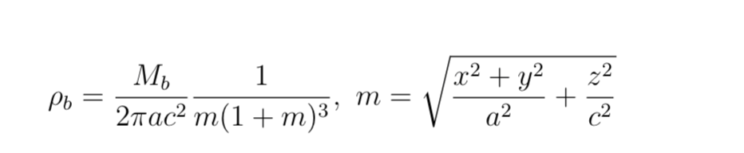
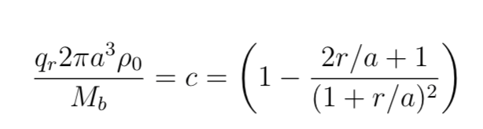
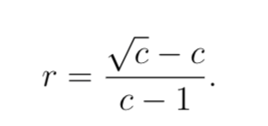
Used Derivation: Bulge
Notes:
Bulge → let a = c, so that m = r/a ; had hoped to change to triaxial when I understood what I was doing

Slide 12
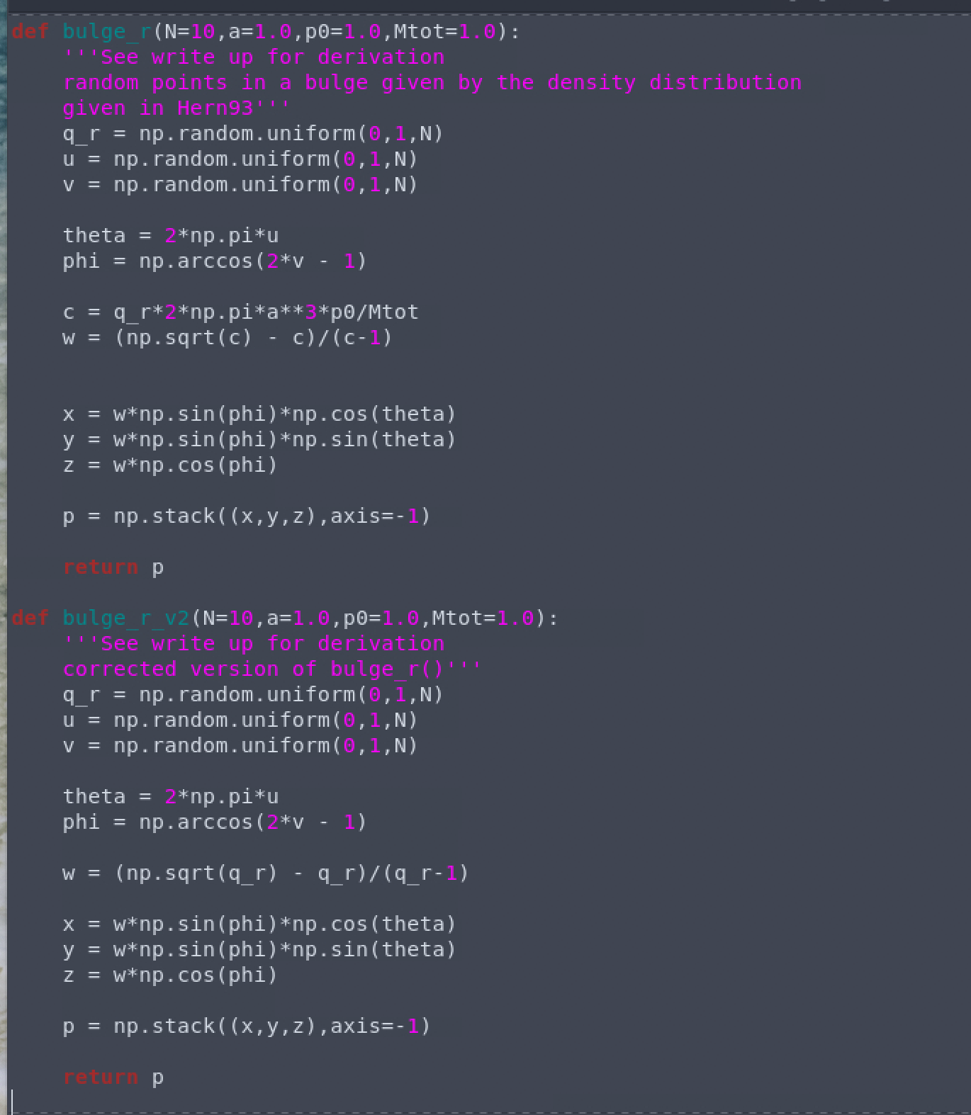
Used Derivation: Bulge
Notes:
Bulge → let a = c, so that m = r/a

Slide 13

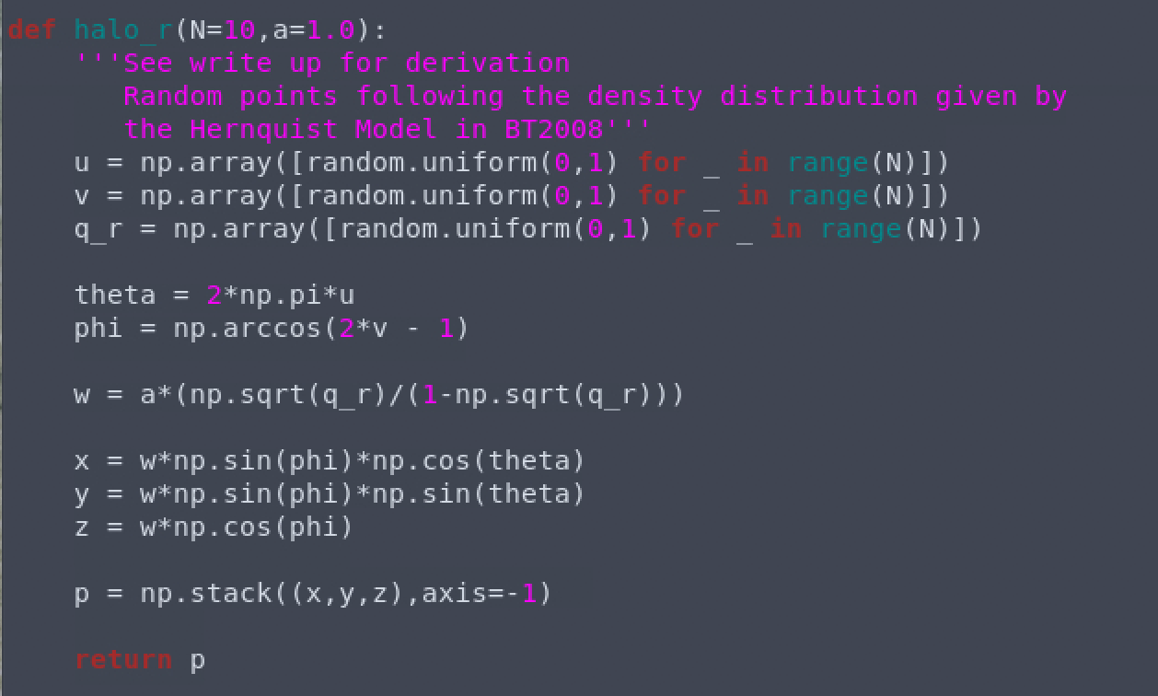
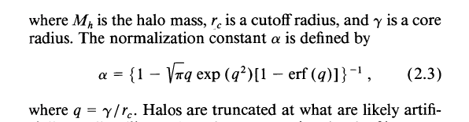
Used Derivation: Halo
Notes:
Note not only way to do this: google says np.arccos is costly; model has cut off radius → perhaps I should have implemented a cut off radius, core radius -

Slide 14
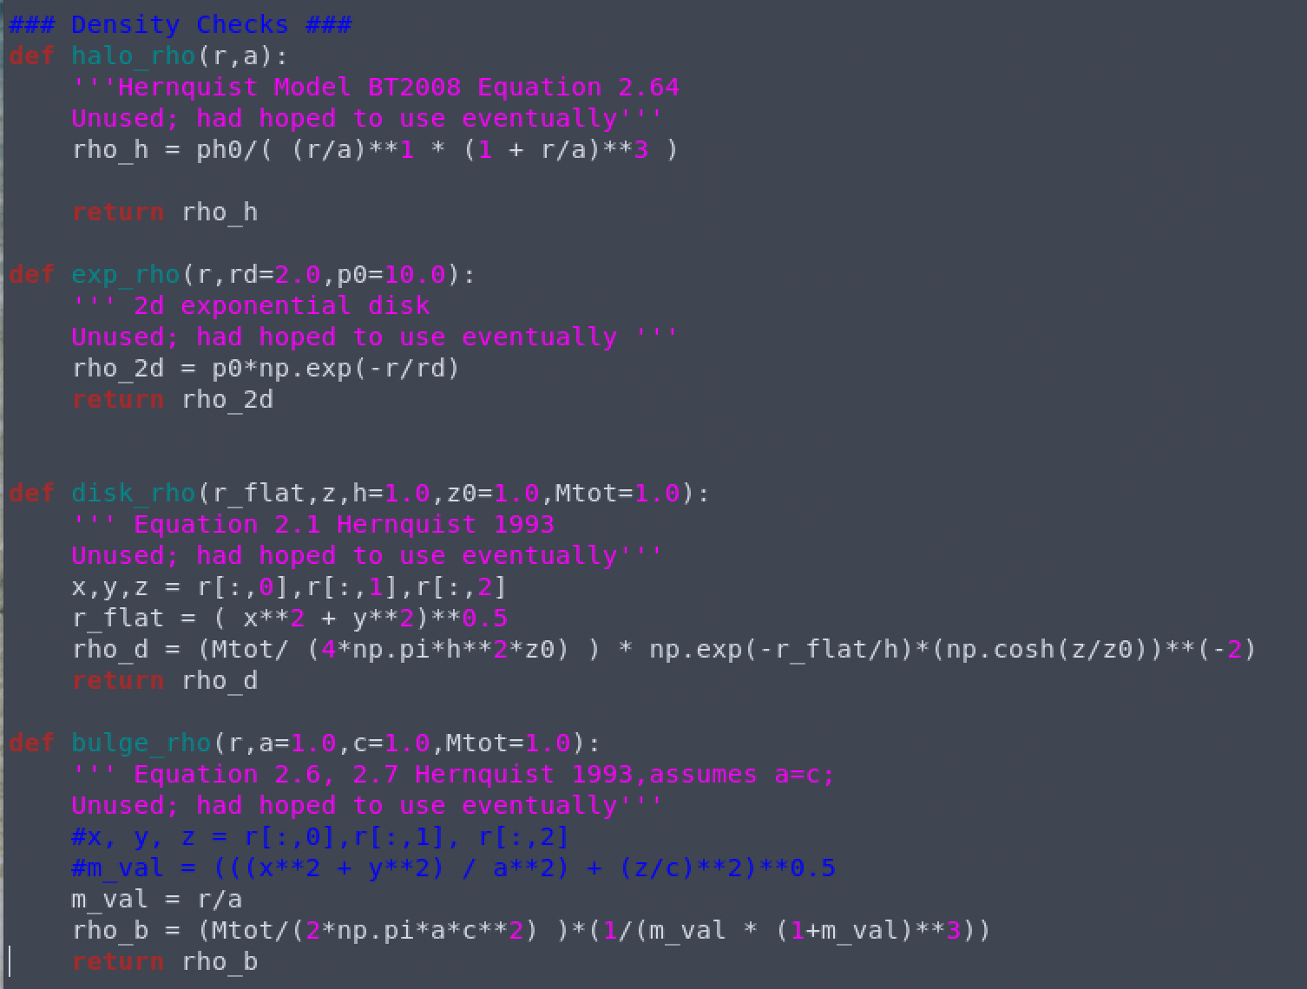
Density Profiles

Slide 15
Hernquist I
Gif v1
Halo+disk+bulge & isolated disk
Gif v2
Halo + disk + bulge & isolated disk
Gif v3
Halo + disk + bulge & isolated disk

Slide 16
Hernquist II
Gif v1
Halo+disk+bulge & isolated disk
Gif v2
Halo + disk + bulge & isolated disk
Gif v3
Halo + disk + bulge & isolated disk

Slide 17
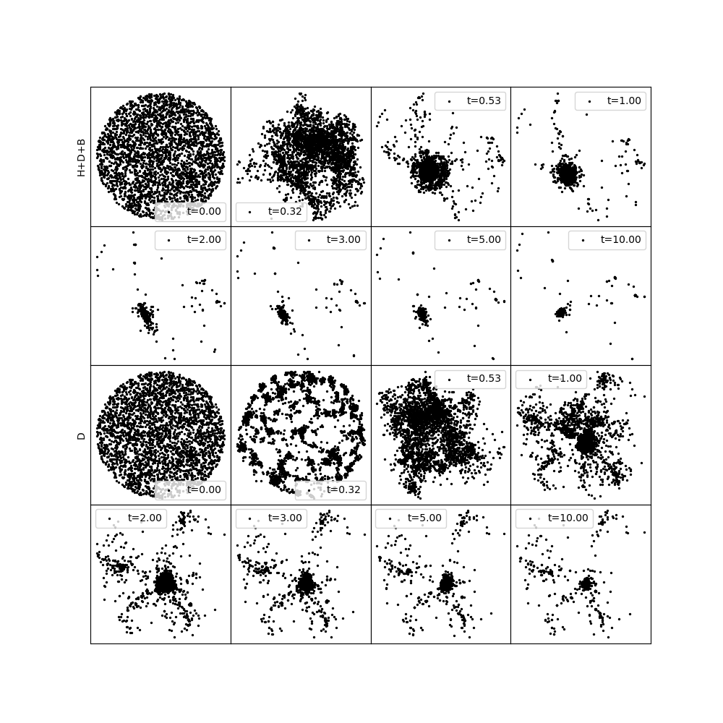
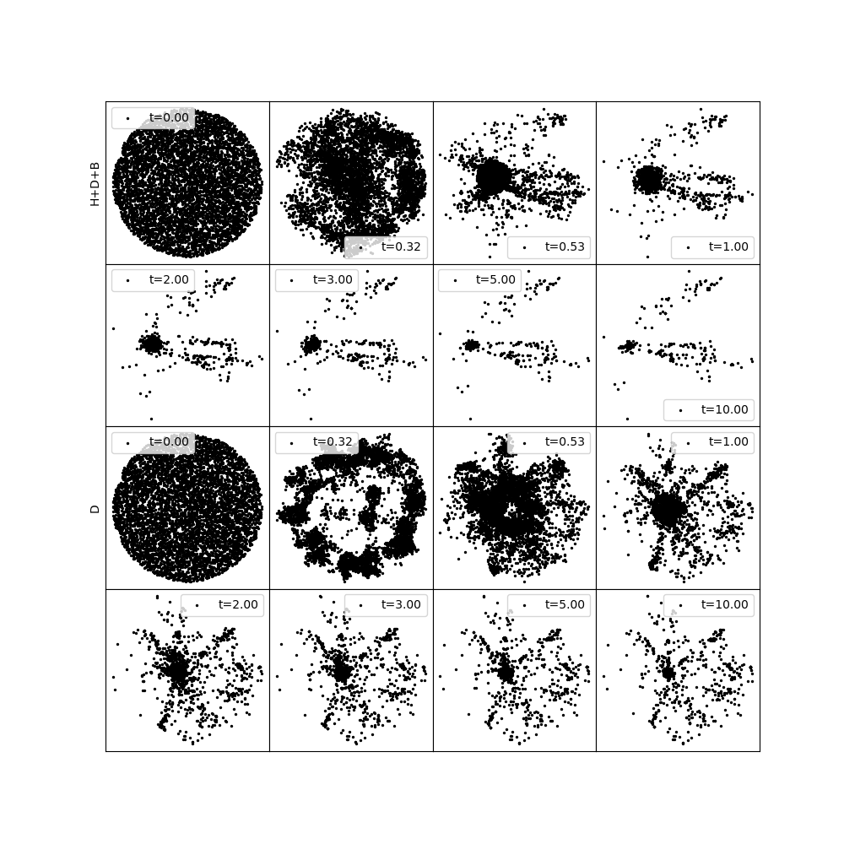
Comparisons from H+D+B vs Isolated Disk

Slide 18
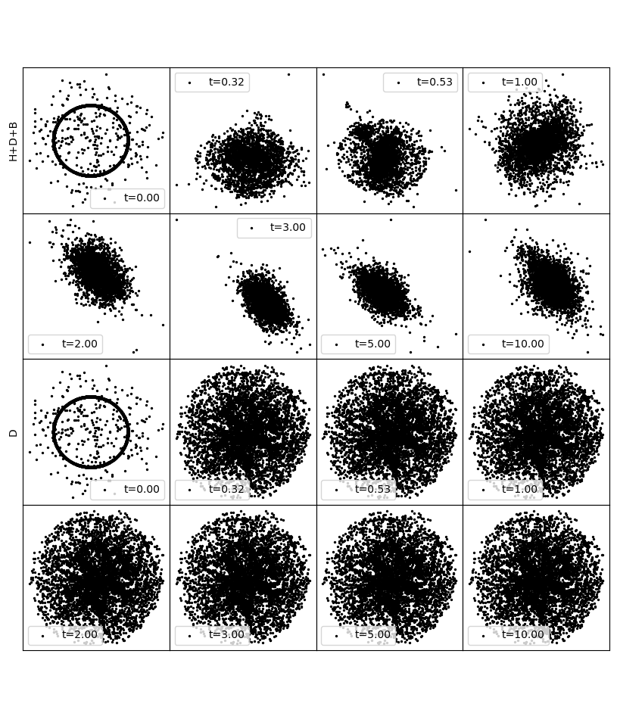
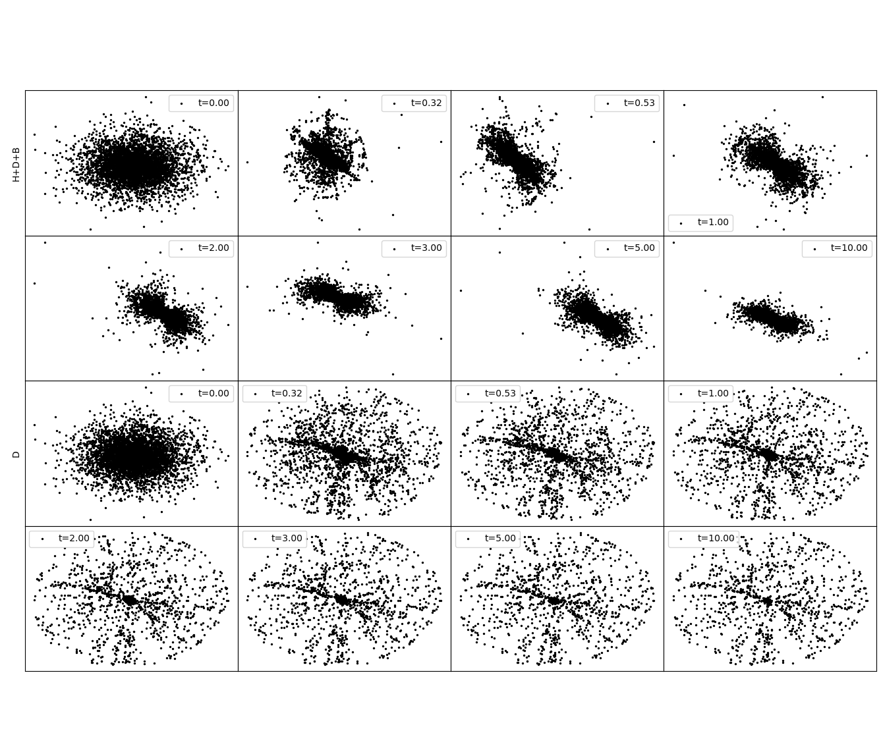
Comparisons from H+D+B vs Isolated Disk

Slide 19
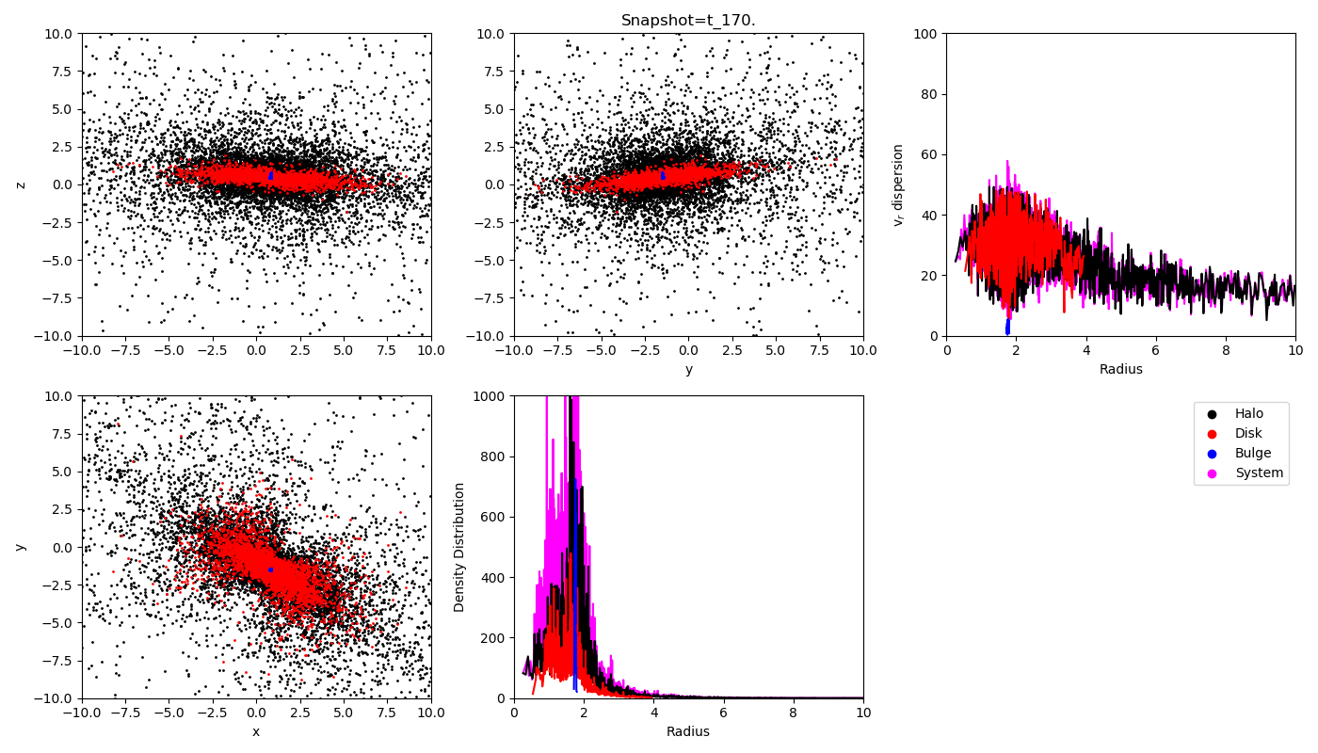
Peanut Galaxy?

Slide 20
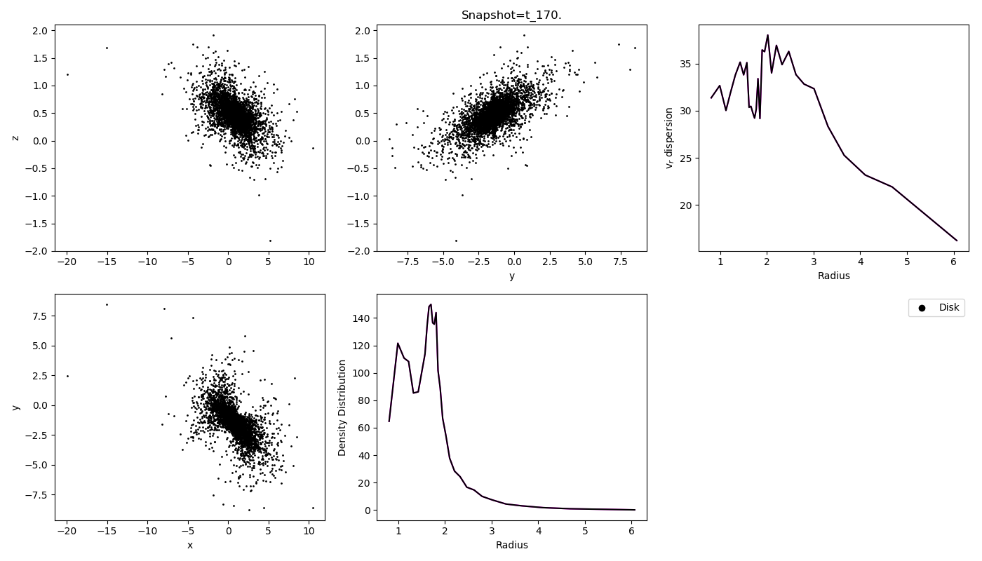
Notes:
1000 N in a bin

Slide 21
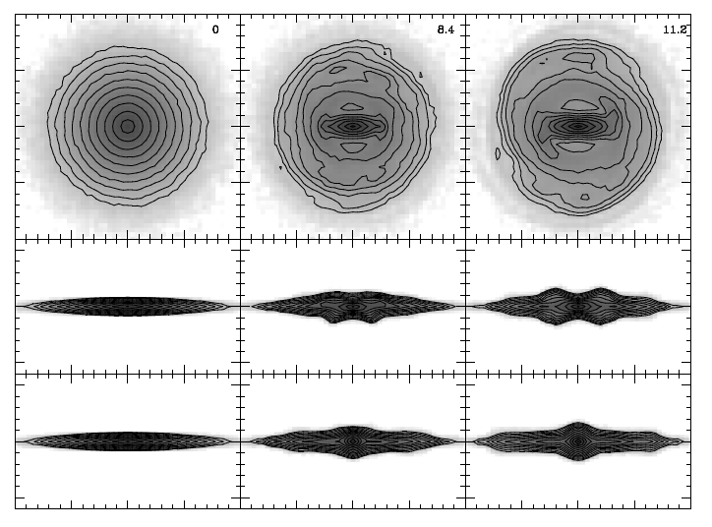

Slide 22
Next Steps
Next simulation
Corrected Bulge equation
Better Velocities -- perhaps Gaussian with 𝛍 = 0 and 𝞼 = 0.2
Slower halo (𝞼 = 10⁻⁵), CDM
Orbits, Epicycles
(Athanassoula 2012)

